Slide 1
www.gcic.peachnet.edu

Slide 2
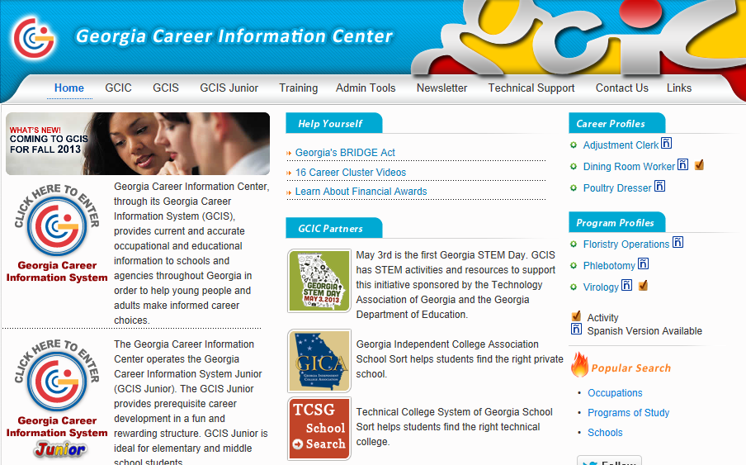
Click on GCIS Jr.

Slide 3
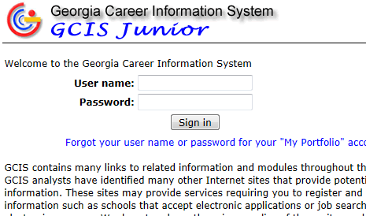
Type in your username and password
Your username is s+ your student number. For example s8463285632
EVERYONE’s password is fulton1

Slide 4
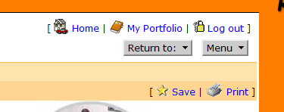
Task #1: Four Year Plan
Click “My Portfolio”
Click “My Course Plan”
Choose “High School Years”
Use your handouts to fill in your Four Year Plan

Slide 5
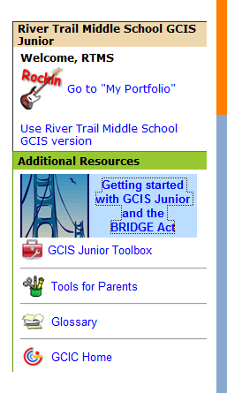
Task 2: To save 3 careers …
Click “Getting started with GCIS Junior
and the BRIDGE Act
Scroll down and click
“8th Grade: 3 Occupations”
You will see a list of occupations. This
list is very general so you may not find
the specific career you are looking for

Slide 6
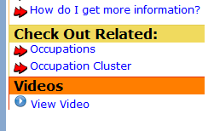
To save an occupation
Click on an occupation of interest
Click on the save button in the right hand corner
Click “Save Information”. You do
not have to type in any thoughts.
To check if you have three, click “My Portfolio” then “My GCIS Favorites”
If you are looking for related occupations
click on “Occupations” under the Check Out Related
heading

Slide 7
Helpful hints
Read your handouts carefully
Do one subject at a time. For example, do math for 9th, 10th, 11th, and 12th grade. Then move on to another subject.
Click “Save Information” often
Each year should have 6 credits total
Pay attention to how may credits a course is worth. Most classes are 1.0 credits but some are 0.5 credits
Req means Required and Elec means Elective

