Slide 1

Parent Presentation
Northview High School
Class of 2019
Home of the Titans

Slide 2
In the interest of time, please hold your questions until the end. It is likely we will answer your question at some point in the presentation tonight. If not, we will take a few questions at the end of the presentation or you may email us your questions. Thank you!

Slide 3
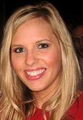
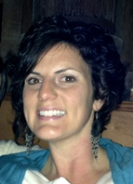
2014-15 Counseling Dept Staff
Kellen Kuglar A – C
Laura
Ashby
D– I
Andy Alhadeff J - Mah

Slide 4
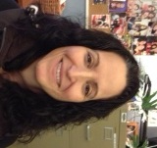


2014-15 Counseling Dept Staff
Renee Ferrerio Mai – N
Allyson Carvell
O-Sj
Letitia Graham
Sk - Z

Slide 5
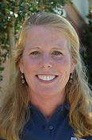
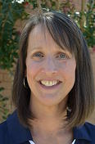
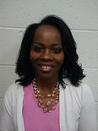
2014-15 Counseling Dept Staff
Meg
Ryan
Counseling Secretary
Cathy Boatwright
Registrar & Records Coordinator
Alicia McClung
School Social Worker

Slide 6
Graduation Requirements
Students must earn a total of 23 credits:
4 English
4 Mathematics
4 Science
3 Social Studies
1 Health/Physical Education
3 CTAE and/or World Language and/or Fine Arts
4 additional elective units
Counselors will conduct classroom guidance lessons and supplementary parent nights to support students in meeting these requirements.
Students planning to enter/transfer into a 4 year college/university must take a minimum of two units of the same world language.

Slide 7
Detailed GRADUATION REQUIREMENTS
Language Arts- 4 units
1 unit of 9th grade Literature and Composition
1 unit of 10th grade Literature and Composition
1 unit of American Literature and Composition
1 unit of Sr Literature
Science- 4 units
1 unit of Biology
1 unit of Physical Science or Physics (AP/IB)
1 unit of Chemistry, Earth Systems, Environmental Science, or
AP/IB Science
1 unit of a 4th science, including any AP/IB, academic science, or career
tech science
Mathematics- 4 units
1 unit of CCGPS Accelerated Coordinate Algebra Honors or CCGPS Coordinate Algebra
1 unit of CCGPS Accelerated Analytic Geometry Honors
1 unit of CCGPS Advanced Algebra or CCGPS Accelerated Pre-Calculus Honors
1 unit of CCGPS Pre Calculus or AP Calculus or AP Stat or 1 additional math unit
Social Studies – 3 units
½ unit of American Government/Civics
1 unit of World History
1 unit of United States History
½ unit of Economics
World Language* AND/OR CTAE** (Career, Technical and Agricultural Education) AND/OR Fine Arts- 3 units
Health/Physical Education- I unit
½ unit of Health
½ unit of Personal Fitness
Electives – 4 units
TOTAL UNITS (Minimum): 23 units
*Students planning to enter or transfer into a University System of Georgia institution or other post-secondary institution must take two units of the same world language.

Slide 8

Earning Credits
Students earn credit for a course by earning a passing grade (70 or higher) in the course.
Grading Scale:
A = 90 or higher
Grade Level Placement:
Freshmen = Less than 5 credits
Sophomore = 5 – 10.5 credits
Junior = 11 – 16.5 credits
Senior = 17 or more credits
F = 69 or below
C = 70-79
B = 80-89

Slide 9
General Grading Policies
Interim progress reports will be issued to students every 6 weeks
Report cards are issued at the end of S1 and S2; these final grades are reflected on the high school transcript
Each course semester is independent of the other; S1 and S2 course grades are NOT averaged
Honors and AP courses receive an additional 7 points added to the final passing grade
Parents can use Home Access Center (HAC) to track assignments, grades, attendance, discipline, etc. during the semester

Slide 10
HOPE GPA
A 3.0 GPA is required by averaging core coursework, including failing grades, on a 4.0 scale
Core Courses Conversion
English
Math
Science
Social Science
World Language
Honors points are removed and a 0.50 weighting is added back in for AP and Dual Enrollment courses only, not to exceed 4.0
Middle school credit is not calculated in the HOPE GPA
All calculations are done by the Georgia Student Finance Commission
A | 90 to 100 | 4.0 Points
B | 80 to 89 | 3.0 Points
C | 70 to 79 | 2.0 Points
F | 0 to 69 | 0 Points
Counselors are not responsible for calculating the HOPE GPA
A 2.99 GPA does NOT qualify you for HOPE

Slide 11
HOPE Scholarship
https://secure.gacollege411.org/Financial_Aid_Planning/HOPE_Program/Georgia_s_HOPE_Scholarship_Program_Overview.aspx
HOPE Specific Eligibility
To receive HOPE Scholarship funding, students must:
Meet one of the following academic requirements:
  Graduate from a HOPE eligible high school with a 3.0 using the HOPE grade point average calculation..
  Earn a 3.0 grade point average at the college level on degree coursework after attempting 30, 60, or 90 semester hours or 45, 90, or 135 quarter hours, regardless of high school graduation status.
Be enrolled as a degree-seeking student at a public or private HOPE eligible college and university in Georgia.
Meet additional rigor requirements, beginning with students graduating from high school on or after May 1, 2015.

Slide 12
HOPE Scholarship
AND:
State Programs Eligibility
Meet U.S. citizenship or eligible non-citizen requirements;
Be a legal resident of Georgia;
Be registered with Selective Service, if required;
Maintain satisfactory academic progress as defined by the college;
Not be in default or owe a refund due on a student financial aid program;
Be in compliance with the Georgia Drug-Free Postsecondary Education Act of 1990.

Slide 13
HOPE Scholarship
The HOPE Scholarship will pay:
At an eligible postsecondary institution, a percentage amount of the standard tuition charges from the previous year.
At an eligible private postsecondary institution, a percentage amount of the HOPE award for private colleges.
Award Amounts:
Payment amount for private and public colleges and universities can be located on GAcollege411.org on the HOPE Program Changes page.

Slide 14
Zell Miller Scholarship
https://secure.gacollege411.org/Financial_Aid_Planning/Scholarships/Zell_Miller_Scholarship/Zell_Miller_Scholarship_Program_Overview.aspx
Zell Miller Specific Eligibility
To receive Zell Miller Scholarship funding, students must meet all HOPE Scholarship eligibility requirements and:
Meet one of the following academic requirements:
  Graduate from an eligible high school as the valedictorian or the salutatorian.
  Graduate from an eligible high school with a minimum 3.7 grade point average combined with a minimum score of 1200 on the math and reading portions of the SAT test or a minimum composite score of 26 on the ACT test in a single national test administration.
  Enroll in an eligible post-secondary institution in 2007 or later, as a freshman, meeting one of the academic qualifications listed above and earn a 3.3 cumulative grade point average at the most recent Zell Miller Scholarship checkpoint.
Be enrolled as a degree-seeking student at a Zell Miller eligible college or university in Georgia.
Meet additional rigor requirements, beginning with students graduating from high school on or after May 1, 2015.

Slide 15
Zell Miller Scholarship
AND:
State Programs Eligibility
Meet U.S. citizenship or eligible non-citizen requirement.
Be a legal resident of Georgia.
Be registered with Selective Service, if required.
Maintain satisfactory academic progress as defined by the college.
Not be in default or owe a refund due on a student financial aid program.
Be in compliance with the Georgia Drug-Free Postsecondary Education Act of 1990.

Slide 16
Zell Miller Scholar Program
A student must maintain a 3.3 grade point average in college to maintain the Zell Miller Scholar program.
If a student loses eligibility for the Zell Miller Scholar program for any reason, they may regain that eligibility one time. They remain eligible for the HOPE Scholarship provided the student’s GPA is still a 3.0 or above.

Slide 17
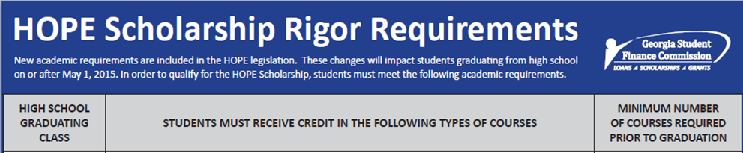
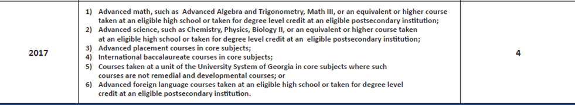
http://www.gsfc.org/main/publishing/pdf/2012/Course_List.pdf

Slide 18
Typical 9th Grade Schedule
Your teachers make recommendations based on the prerequisites listed in the academic catalogue- online at www.northviewhigh.com
Individual departments determine the prerequisites (not the counselors)
Research classes carefully
Be aware of the scheduling policy. We do not change schedules unless there is an error on our part.
Semester One | Semester Two
9th Grade English (Honors) | 9th Grade English (Honors)
Math (Honors) | Math (Honors)
American Gov’t or Health | American Gov’t or Health
World Language (Honors) or another elective | World Language (Honors) or another elective
Biology (Honors) | Biology (Honors)
Elective | Elective

Slide 19

Final Exams and End-of-Course Tests
Georgia Milestones:
Biology*
Physical Science
9th Lit/Comp*
11th Lit/Comp
CCGPS Coord. Algebra*
CCGPS Geometry
US History
Economics
The GA Milestones is weighted at 20% of a student’s final course grade (S2)
Most teachers will weight the S1 final the same as the GA Milestone
9th grade courses are marked with an *
Final exams are given in all other courses – see teacher syllabi for details

Slide 20
Course Placement
Your teachers make recommendations based on prerequisites posted in the academic catalogue
SCIENCE
26.0120000 | Biology | Y | 1.0 | None; 9
26.0120040 | Biology Honors | Y | 1.0 | 88+ Advanced Science or 95+ On-level Science; 9
LANGUAGE ARTS
23.0610000 | 9th Grade Lit/Comp | Y | 1.0 | None; 9
23.0610040 | 9th Grade Lit/Comp Honors | Y | 1.0 | 85+ unweighted Lang Arts 8 Advanced or 95+ regular 8th grade Language Arts; recommendation from Grade 8 Language Arts teacher; Level 3 score on CRCT Reading and Language Arts (if applicable); 9

Slide 21
Course Placement
Your teachers make recommendations based on prerequisites posted in the academic catalogue
SOCIAL STUDIES
45.0570005 | American Government / Civics | S | 0.5 | None
NO WAIVERS permitted for 9th grade AP courses. Students must meet specified criteria.
AP Government Requirements for rising 9th graders: 88+ in 8th Grade History, 88+ in Language Arts Advanced.
Students may need to remove General Health and/or American Government from their schedule to make room for an AP course. Summer school and online options are available to rising 9th graders at the parent’s expense. Approximate cost for two classes taken during the summer is $500.
AP Gov’t is a yearlong course. AP Gov’t fulfills the American Gov’t graduation requirement.
Students must have the ability to learn independently, though they will have support in class.
Students should be strong with social studies skills including political cartoons and reading comprehension.
Students will be required to read material regularly on their own. When reading, students should read for detail; application and background of the concepts will be given in class.
The course is heavy on memorization of vocabulary and key concepts since tests/quizzes will be formatted to AP style multiple choice questions and free response questions. These questions will require students to use critical thinking skills to apply their knowledge of concepts/vocabulary to real world examples.
AP Human Geography requirements for rising 9th graders: 88+ in 8th Grade History, 88+ in Language Arts Advanced (same skill set as listed above). AP Human Geography is a yearlong course.
See note above regarding General Health and/or American Gov’t

Slide 22
Course Placement
Your teachers make recommendations based on prerequisites posted in the academic catalogue
WORLD LANGUAGES
62.0110000 | Chinese I | Y | 1.0 | None
62.0120000 | Chinese II | Y | 1.0 | 70 – 89 Chinese 8
62.0120040 | Chinese II Honors | Y | 1.0 | 90+ Chinese 8
60.0110000 | French I | Y | 1.0 | None
60.0120000 | French II | Y | 1.0 | 70 – 91 French 8
60.0120040 | French II Honors | Y | 1.0 | 92+ French 8
61.0110000 | German I | Y | 1.0 | None
61.0120000 | German II and II Honors | Y | 1.0 | German 8
61.0410000 | Latin I | Y | 1.0 | None
60.0710000 | Spanish I | Y | 1.0 | None
60.0720000 | Spanish II | Y | 1.0 | 70 – 91 Spanish 8
60.0720040 | Spanish II Honors | Y | 1.0 | 92+ Spanish 8

Slide 23
Course Placement
Your teachers make recommendations based on prerequisites posted in the academic catalogue
MATHEMATICS
27.0971000 | CCGPS Coord Algebra | Y | 1.0 | Math 8A 70 – 84; Math 8O 70 – 89; 9
27.1981000 | CCGPS Coord Algebra Support | Y | 1.0 | Passed Math 8 with 70-75 and/or enrolled in ABE Math 8 for two quarters - take with CCGPS Algebra; Course is required, no waivers permitted; 9
27.0975040 | CCGPS AccCoord Alg Honors | Y | 1.0 | 88+ Math 8A, 98+ Math 8 O level; NO Waivers permitted for 8 O students. Must have a final grade of 98 to take the accelerated course from level 8 O; 9
27.0976040 | CCGPS Accelerated Analytic Geometry Honors | Y | 1.0 | 83+ unweighted CCGPS Accelerated Coord Algebra H; 9,10

Slide 24
A Word On Math….
Students taking CCGPS Accelerated Coordinate Algebra Honors in 9th grade, will take CCGPS Accelerated Analytic Geometry Honors in 10th grade, CCGPS Accelerated Pre-Calculus Honors in 11th grade, and MUST take AP Calculus or AP Statistics in 12th grade in order to graduate. There are limited alternatives!!
If you are recommended for the Accelerated path you must have extremely high math grades and a 3 on your 8th grade CRCT in math.
In addition to being a very strong math student, you must also be a very strong test taker. 90% of your grade will be earned from demonstrating content mastery on quizzes, tests and alternative assessments.
Even if your 8th grade math teacher has recommended you for Accelerated math, you need to have a serious discussion with your parents to be SURE this path is right for you.

Slide 25
High School Academic Placement
All Academic course placements are subject to change. Students are currently placed based on first semester and current grades in pre-requisite courses.
If final second semester grades in pre-requisite courses or 8th CRCT scores drop below the necessary grades to be placed in Honors level courses, students will be removed before the beginning of the 2015/2016 School Year.

Slide 26
Course Verification Form
On the front of the course verification form, there will be a listing of all of your academic courses currently selected by your teachers (subject to change upon receipt of final second semester grade)
These courses should total 4.0 units if you are not currently in a World Language or 5.0 units if you are continuing on to a second year of World Language.

Slide 27
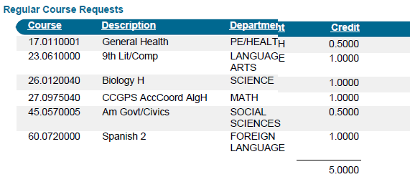
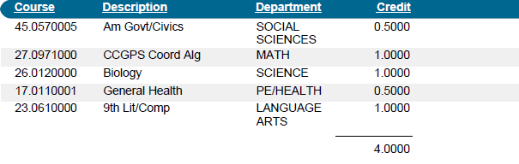
Front Page of Verification Form- two examples
5 units of credit- student is taking World Language *Student will select 1.0 units of electives
4 units of credit- student is not taking World Language *Student will select 2.0 units of electives

Slide 28
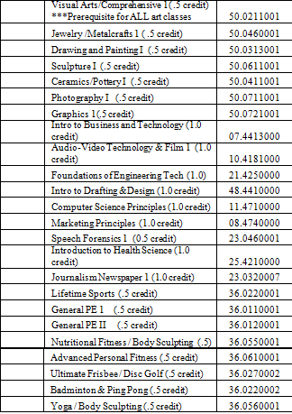
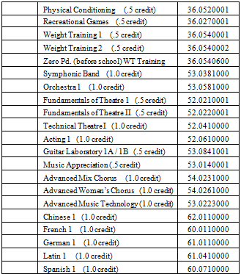
Course Selection
ELECTIVE CHOICES:
List your elective choices in order of priority from 1 – 8. You will find the course descriptions in your Northview Curriculum Handbook. The handbook can be accessed at www.northviewhigh.com. Enrollment in each course is limited, and we will honor as many requests as possible. If you do not list eight choices and we cannot honor your other requests, we will select the elective for you. Any course listed on this form may be used to complete the student schedule.
Mark eight (8) elective choices even if you have six academic classes listed above. Courses may be cancelled over the summer and we need course options to complete your schedule.
Elective Options (number 1- 8)

Slide 29
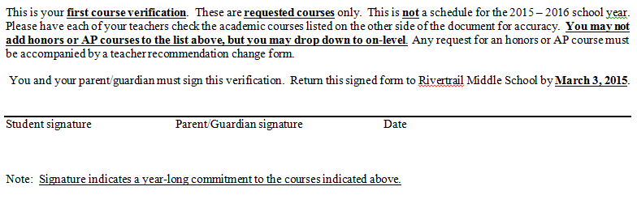
Parent Signature- Course Verification Form
Parent signature is REQUIRED, not optional !
Your course verification form will not be accepted at Northview High or processed without signature
Lack of signature will impact your opportunity to take selected courses

Slide 30
What Happens Next?
Students must turn in their course selection form to their middle school counselor, Ms. Woods, by 2/27/15.
Students will receive a first verification form after 3/10/15. This form will include academics and elective choices. At this time students and parents can look over the form and make changes to electives or correct errors to academic selections (with teacher signatures). These will be sent back to the high school to be updated.
Remember that at the end of the 2014/2015 school year, adjustments will be made to academic courses if grades or CRCT scores dip below the required level to be placed in honors level courses.

Slide 31

Utilize our website at http://www.northviewcounseling.com

Slide 32
Counseling Programs 9th Grade
9th grade-
  Summer camp Up Next prior to start of HS
  9th Advisement in Fall
  Individual 4 year planning in Spring
  Career Advisement through GCIS
  Small Group topics (career, back on track, study skills, stress & anxiety, self esteem, girls group, boys group, freshmen balance)
  9th Grade Parent Night
  PSAT Score Interpretation Night
  College Fair
  Career Fair
  AP Night
  College Week
  Career Week
  No Place for Hate activities
  And more……

Slide 33
Counseling Programs 10th Grade
10th grade-
  10th Advisement in Fall
  Individual 4 year planning in Spring
  Small Group topics (career, back on track, study skills, self esteem, girls group, boys group ,stress & anxiety)
  Practice SAT/ACT Test options
  10th Grade Parent Night
  College Fair
  Career Fair
  AP Night
  College Week
  Career Week
  No Place for Hate activities
  And more……

Slide 34
Counseling Programs 11th Grade
11th grade-
  11th Advisement in Fall and Spring
  Junior Status Conferences in Spring
  College Advisement through GCIS
  Small Group topics (career, back on track, study skills, self esteem, girls group, boys group, stress & anxiety)
  College Transition and Test Prep Summer Camp
  SAT/ACT Prep courses
  Junior Parent Night
  Dual Enrollment Night
  College Fair
  Career Fair
  AP Night
  College Admission Rep Visits
  College Week
  Career Week
  No Place for Hate activities
  And more……

Slide 35
Counseling Programs 12th Grade
12th grade-
  12th Advisement in Fall and Spring
  Small Group topics (career, back on track, study skills, self esteem, girls group, boys group, stress & anxiety)
  Financial Aid Night
  Georgia Apply to College Day
  Transcript and College Application Process
  College Admission Rep Visits
  College Week
  Career Week
  Letter of recommendation
  Clinics on Essay Writing
  College admission guidance
  No Place for Hate activities
  And more……

Slide 36
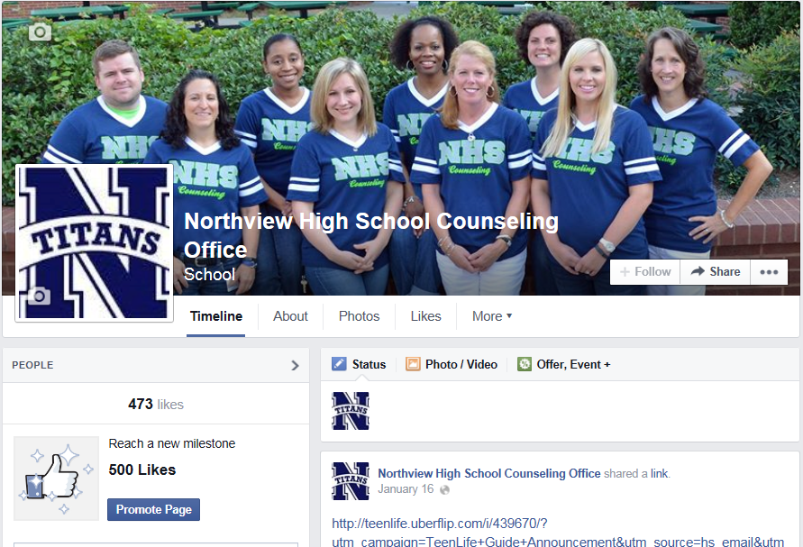
Check us out on Facebook at facebook.com/NHSTitansCounseling

Slide 37

Check us out on Twitter @NHSCounseling1

Slide 38
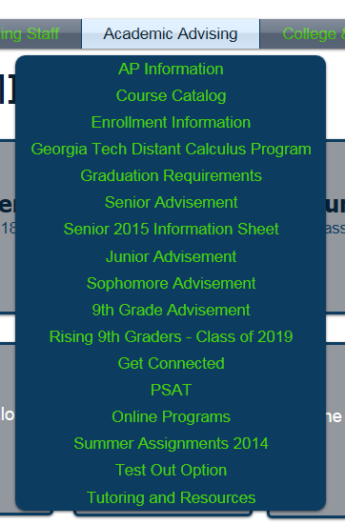


Click on Academic Advising Tab to access Rising 9th grade pre-registration topics

Slide 39
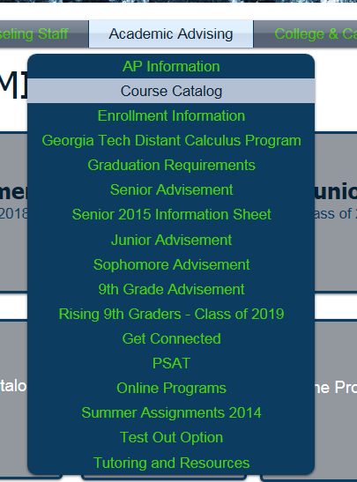
Access the Course Catalog and read course descriptions at http://www.northviewhigh.com/pages/resources/coursecatalog.php

Slide 40

Up Next Summer Camp Hosted by NHS Counseling and Princeton Review

Slide 41


Slide 42
FAQ Topics & Answers
Teacher Placement Changes
Waiver Forms
Summer Online Programs
Verifications vs Schedules
Additional Questions

Slide 43
Class of 2019 Distribution List
If you have not been receiving E-blasts from NHS Counseling, please send an email to Ferrerio@fultonschools.org . In the email list your students LEGAL name, grade level and student and parent email addresses. We will be happy to add you to our distribution list.

Slide 44
THANK YOU for Attending!!
Thank you for attending this evening. Please feel free to email any of the counselors at NHS with any further questions you may have.
This power point presentation will be posted on our website at: http://northviewhigh.com/counseling/
Follow us on Facebook: facebook.com/NHSTitansCounseling
Follow us on Twitter: @NHSCounseling1

