Slide 1


Georgia’s BRIDGE Act

Slide 2

Building Resourceful Individuals to Develop Georgia's Economy Act

Slide 3

Using GCIS Junior for
Middle School Students

Slide 4
What is the BRIDGE Act?
BRIDGE is an acronym for “Building Resourceful Individuals to Develop Georgia’s Economy”.
Ensures that Georgia’s 6th -12th grade students are aware of available career and postsecondary education options.
Your school can use the Georgia Career Information System (GCIS) and Georgia Career Information System Junior (GCIS Junior) to fulfill the requirements of the BRIDGE Act.

Slide 5
BRIDGE Act Objectives for Middle School Students
Before the end of the second semester of the eighth grade, students shall develop an individual graduation plan in consultation with their parents, guardians, or individuals appointed by the parents or guardians to serve as their designee.
Middle school students shall be provided counseling, advisement, career awareness, career interest inventories, and information to assist them in evaluating their academic skills and career interests.

Slide 6

Portfolios
Be sure to create a GCIS Junior Portfolio for every student before completing any BRIDGE Act activities. This is how the data is collected and reported to the Georgia Department of Education.
This Portfolio can be transferred to the high school to continue the students’ career development.

Slide 7
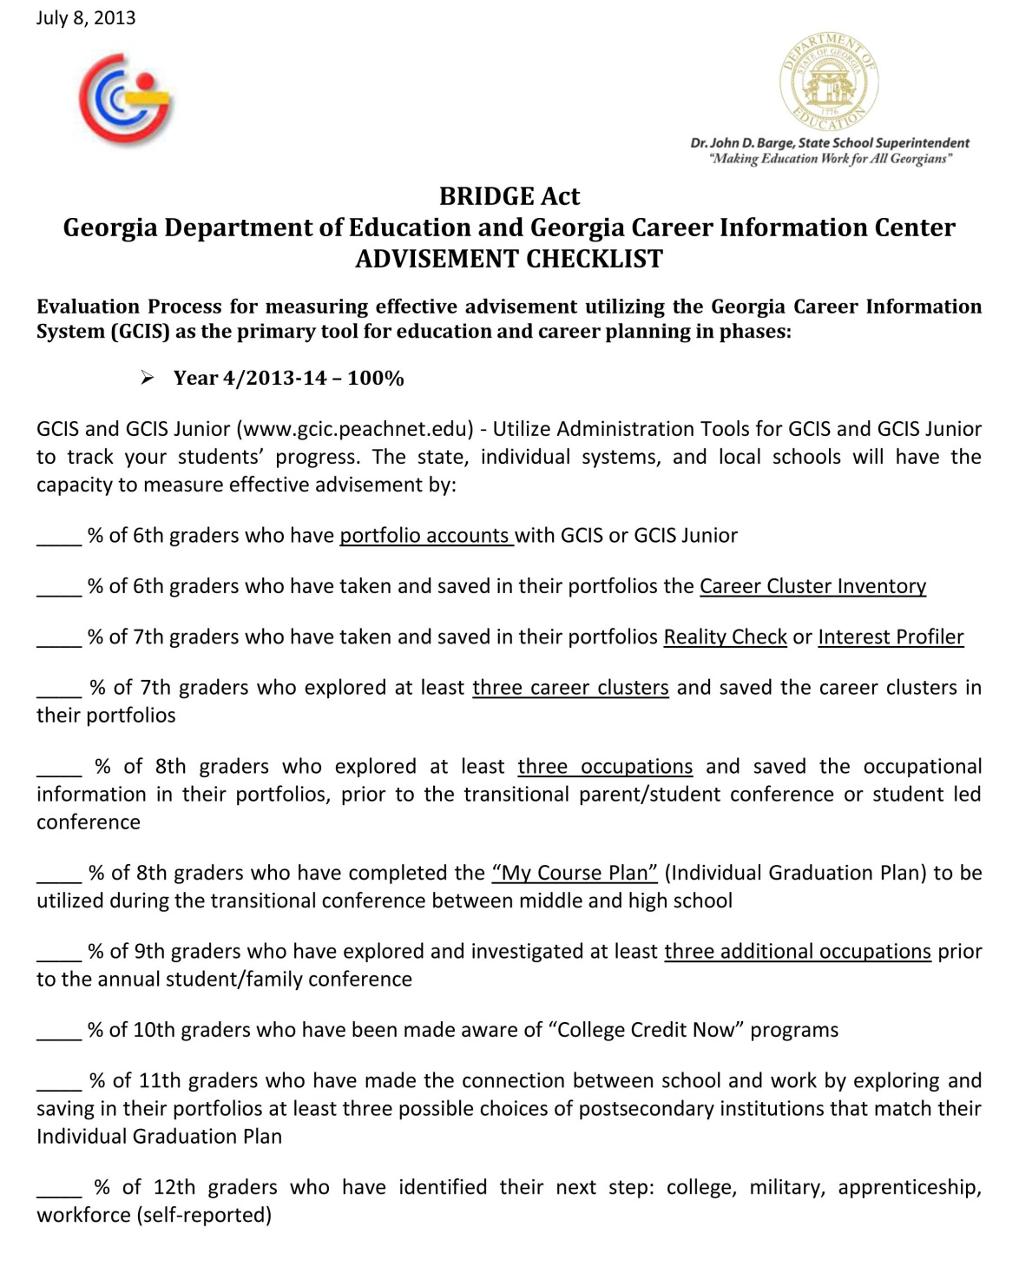
GCIS-GCIS Junior
Advisement Checklist
This is the official advisement checklist used by the Georgia Career Information Center to report your students’ completion of BRIDGE Act career development activities.
Copyright © 2011 Board of Regents of the University System of Georgia, Georgia State University, Georgia Career Information Center and its licensors. All rights reserved.

Slide 8
Getting Started with GCIS Junior and the BRIDGE Act
6th Grade: Career Cluster Inventory -- complete Career Cluster Inventory and save it in your portfolio.
7th Grade: Reality Check -- complete Reality Check or Interest Profiler and save it in your portfolio.
7th Grade: 3 Career Clusters -- explore at least 3 career clusters and save them in your portfolio.
8th Grade: 3 Occupations -- explore at least 3 occupations and save them in your portfolio.
8th Grade: "My Course Plan" -- complete the "My Course Plan" (4-Year Individual Graduation Plan) in your portfolio.

Slide 9
6th Grade:
Portfolios
6th Grade:
Career Cluster Inventory
7th Grade:
Reality Check
7th Grade:
3 Career Clusters
8th Grade:
3 Occupations
% of 8th graders who have explored at least 3 occupations and saved them in their portfolios.
8th Grade:
"My Course Plan"
% of 8th graders who have completed the "My Course Plan" (Individual Graduation Plan).
% of 7th graders who have explored at least 3 career clusters and saved them in their portfolios.
% of 7th graders who have completed Reality Check and saved in their portfolios.
% of 6th graders who have completed Career Cluster Inventory and saved in their portfolios.
% of 6th graders who have portfolio accounts with GCIS or GCIS Junior.
BRIDGE Act Reports

Slide 10
Additional BRIDGE Act Resources
Using GCIS and GCIS Junior for the BRIDGE Act
  http://www.gcic.peachnet.edu/Content/HelpYourself/BridgeAct.aspx
House Bill 400: Building Resourceful Individuals to Develop Georgia's Economy Act (BRIDGE Act)
  http://www.legis.state.ga.us/legis/2009_10/versions/hb400_HB_400_AP_12.htm
GCIS-GCIS Junior Advisement Checklist
  http://www.gcic.peachnet.edu/Content/HelpYourself/Document/ADVISEMENT%20Checklist%20GCIS.pdf
Resources for “College Credit Now”
  http://www.dtae.org/teched/highschoolinit.html
  http://www.usg.edu/student_affairs
  http://public.doe.k12.ga.us/ci_cta.aspx?PageReq=CICTASeam

Slide 11
Georgia Career Information Center www.gcic.peachnet.edu
Georgia’s BRIDGE Act
Building Resourceful Individuals to Develop Georgia's Economy Act
Using GCIS Junior for Middle School Students

